Slide 1

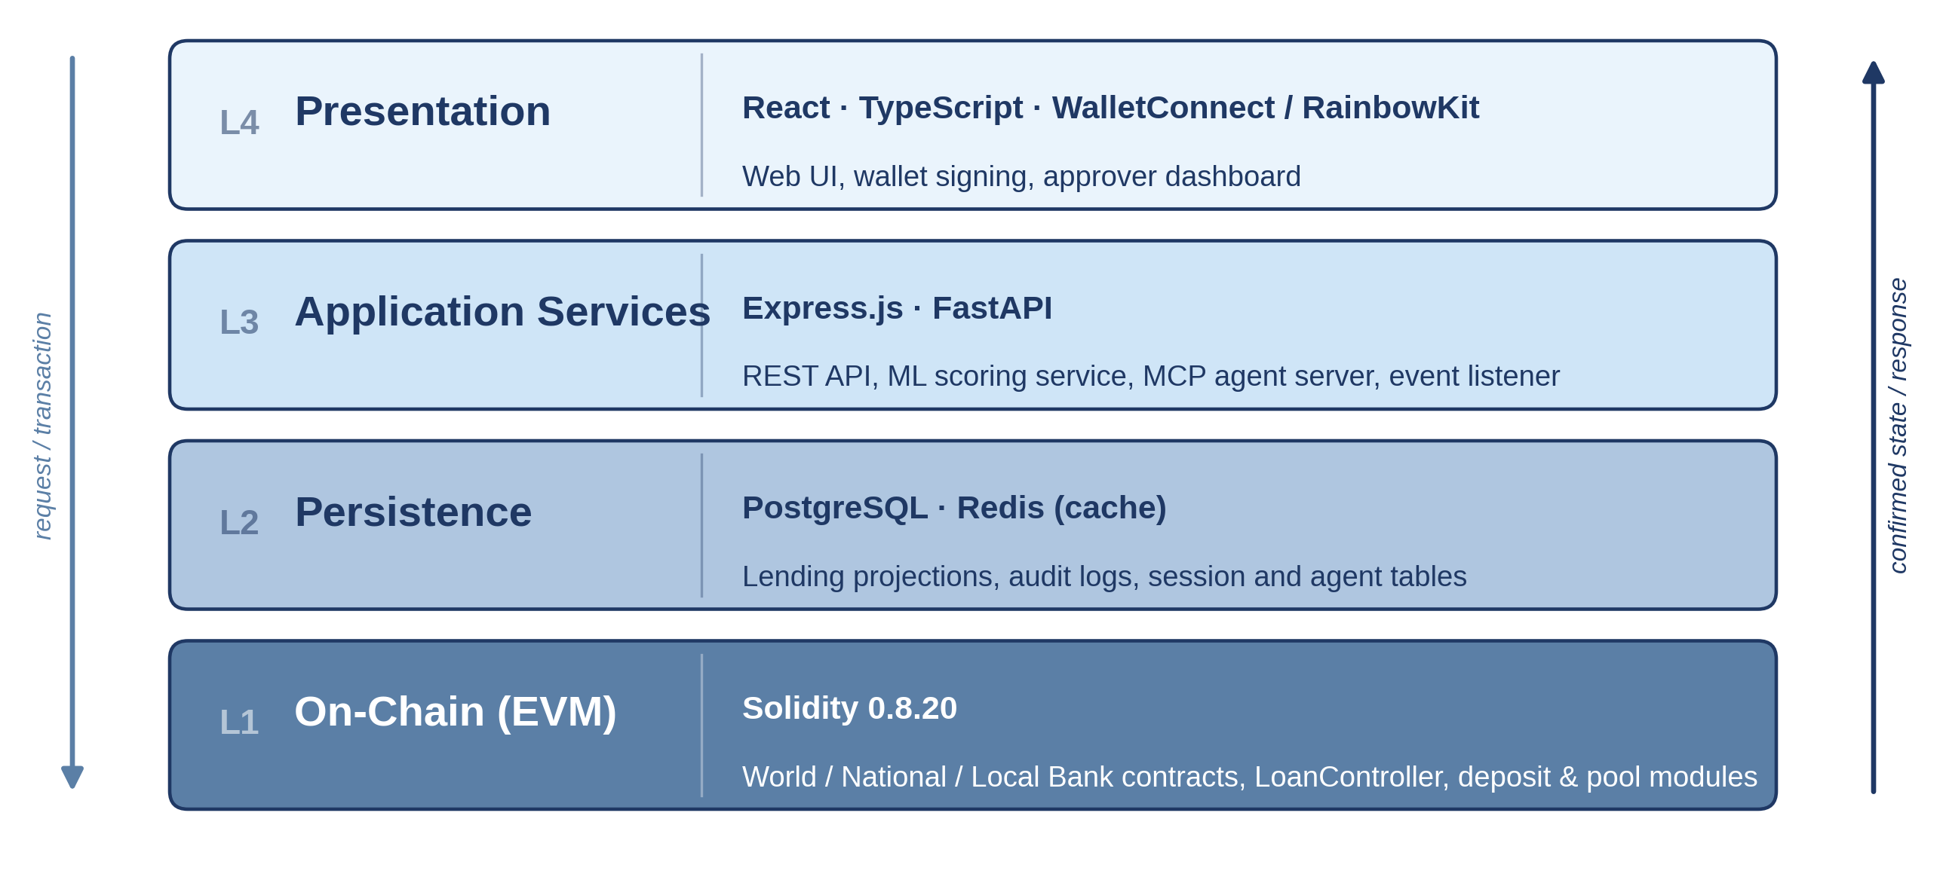
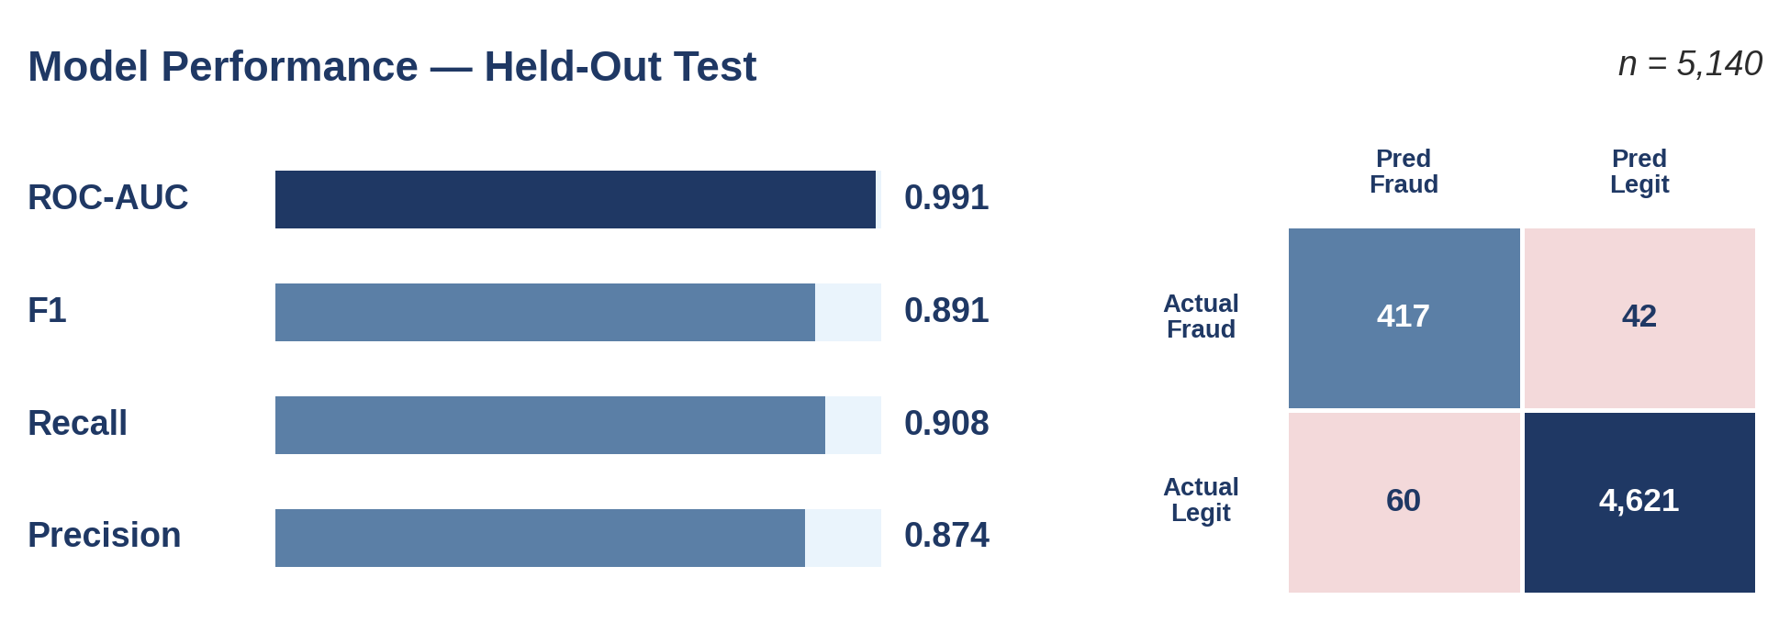
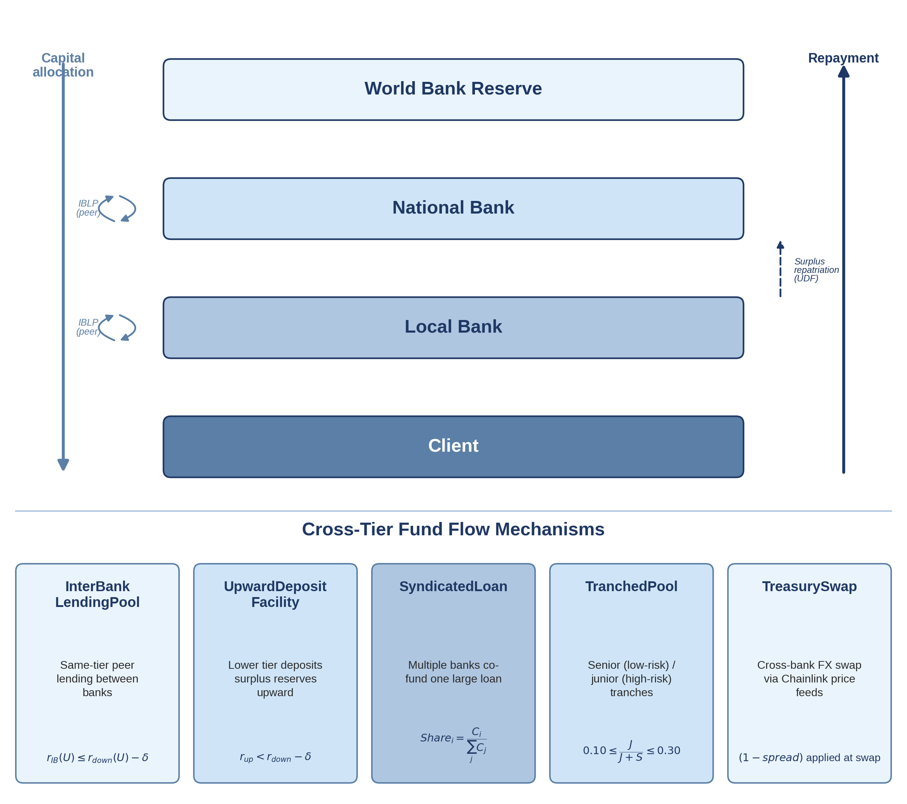
Decentralized Crypto World Bank
A Blockchain-Based Banking Platform with AI-Enhanced Security and Assistance
BRAC University Department of Computer Science and Engineering
Md. Bokhtiar Rahman Juboraz (20301138) | Md. Mahir Ahnaf Ahmed (20301083)
Supervisor: Mr. Annajiat Alim Rasel, Senior Lecturer, Dept. of CSE, BRAC University
Abstract
System Architecture
Result Analysis
Modern institutional banking is organized in restrictive layers that limit equal access to financing. Crypto World Bank (CWB) specifies a four-tier, hierarchically-governed DeFi platform — World Bank reserve → National → Local Banks → Clients — mirroring real-world development finance while enforcing reserves, credit allocation, and risk analytics on-chain. Six on-chain banking functions (deposits, credit allocation, settlement, risk intermediation, liquidity management, ancillary services) sit behind a five-layer defense-in-depth security model. AI-driven fraud detection (Random Forest + Isolation Forest, F1 = 0.891) and an optional MCP-based conversational agent enhance security and usability, showing a transparent, open-source alternative to flat DeFi lending is achievable.
Dataset: BCCC-DeFiFraudTrans-2025 (York Univ.), 50,000-txn subsample, 8.65% fraud rate, 21 features. Model: Random Forest (80 trees) + Isolation Forest (80 trees) + logistic stacking.
Model Performance (Confusion Matrix)
 | Predicted: Fraud | Predicted: Legit
Actual: Fraud | TP = 417 | FN = 42
Actual: Legit | FP = 60 | TN = 4,621
Introduction
1.1 Background
Layered institutions (World → National → Local → Client) suffer settlement friction, opaque reserves, and idle correspondent-banking capital; flat DeFi (Aave, Compound, MakerDAO) ignores this hierarchy entirely.
1.2 Rationale / Motivation
Encode institutional hierarchy on a programmable ledger — enforced reserves, role-based governance, auditable capital flow — supporting (not replacing) human credit judgment.
1.3 Problem Statement
Six inefficiencies: low transparency, slow/costly settlement (~$45, 2–5 days), inconsistent risk evaluation, high trust/audit costs, no programmable savings, no on-chain group credit.
1.4 Objectives
Specify a 4-tier EVM lending architecture with an extended banking suite, off-chain ML risk analytics, and an optional conversational agent; deploy and evaluate on testnets.
1.5 Proposed Solution
Four-tier on-chain model (World Bank reserve → National → Local Banks → Clients) enforcing six banking functions on-chain: deposit mobilization, credit allocation, settlement, risk intermediation, liquidity management, ancillary services.
1.6 Key Contributions
Novel four-tier + AI/ML combination; five on-chain multi-entity mechanisms (interbank pools, upward deposits, syndicated loans, tranched pools, treasury swaps); commit–reveal ML oracle with immutable audit trail; five-layer defense-in-depth security; optional MCP-based conversational agent (Qwen3-8B, 17 banking tools).
BCCC Benchmark Results (Held-Out Test)
Split | Precision | Recall | F1 | ROC-AUC | n
Test | 0.874 | 0.908 | 0.891 | 0.991 | 5,140
Decision Bands: Approve s<0.4 · Manual review 0.4–0.7 · Reject s≥0.7 (SHAP-explained, human-reviewed)
Four-Tier Hierarchy & Cross-Tier Fund Flows
Conclusion
System Requirements Analysis
➤ First specification combining a 4-tier institutional hierarchy with DeFi and AI/ML risk analytics — not previously demonstrated in the literature.
➤ Shows a programmable lending platform can improve transparency and security across World→National→Local→Client capital flows.
➤ Core DeFi stack follows conventional design; the 4-tier + AI/ML integration is the project's original contribution.
➤ Economically viable at prototype scale: NPV ≈ $149.7k and positive ROI over a 3-year horizon at 10% discount rate (Section 5.4).
Future Work
➤ Deploy on Polygon zkEVM Cardona; live reserve-transparency dashboard & multisig admin.
➤ Expand interbank pools, group lending, upward deposits; zkKYC/zkAML, Certora proofs, federated learning.
➤ Formal verification (Certora), GraphSAGE graph-ML fraud scoring, and Chainlink Functions/Automation/PoR for production-grade oracle upgrades.
Full FR/NFR sets are specified in the report; representative items below.
Type | ID | Description
Functional | FR-01 | Four-tier hierarchy: World→National→Local→Client, role-gated capital allocation
Functional | FR-02 | Loan lifecycle: request → ML score → approval → disbursement → repayment
Non-Functional | NFR-01 | Performance: ML inference ≤50ms; API p95 ≤500ms
Non-Functional | NFR-02 | Security: RBAC, ReentrancyGuard, human approver gate
Functional | FR-03 | Multi-entity ops: InterBankLendingPool, UpwardDepositFacility, SyndicatedLoan, TranchedPool, TreasurySwap
Methodology
References
Agile/Scrum development across 4 phases (3–5 weeks each, 16 weeks total); team of 2, weekly Tuesday sync with supervisor.
➤ Stack: Solidity · React · Express.js/FastAPI · PostgreSQL · scikit-learn
➤ Testnets: Ethereum Sepolia & Polygon zkEVM Cardona
➤ Phase I–IV: architecture spec → loan-cycle demo → ML + oracle → evaluation
➤ MVC pattern: contracts / frontend (React) / backend (Express)
➤ Security: 5-layer defense-in-depth — contract guards → API/rate-limits → ML fraud screening → monitoring → multisig governance
[1] S.M. Werner et al. SoK: Decentralized Finance (DeFi). arXiv:2101.08778, 2022.
[9] World Bank. The Global Findex Database 2021.
[13] IFC. MSME Finance Gap. World Bank, 2017.
[18] DefiLlama. Aave V3 TVL, Fees, Revenue & Income Statement, 2026.
[99] BCCC, York University. BCCC-DeFiFraudTrans-2025, 2025.
[15] CPMI & BIS. Correspondent Banking — Technical Report. BIS CPMI Papers No. 147, 2016.
[17] World Bank. Remittance Prices Worldwide. Migration & Development Brief 40, 2024.
[21] Fensory. Maple Finance — Institutional DeFi Lending Protocol, 2026.
[25] World Bank. World Bank Group Tracks Project Funds with New Blockchain Tool (FundsChain), 2025.
[26] JPMorgan. Kinexys Digital Payments: Real-Time Multicurrency Payments, 2025.

